Slide 1
DBMS Project on Mentoring activity session
Project by: Tarun Marwadi , Sanket Kamble , Ritik Patil , Shriharsh Patange(TEIT)

Slide 2
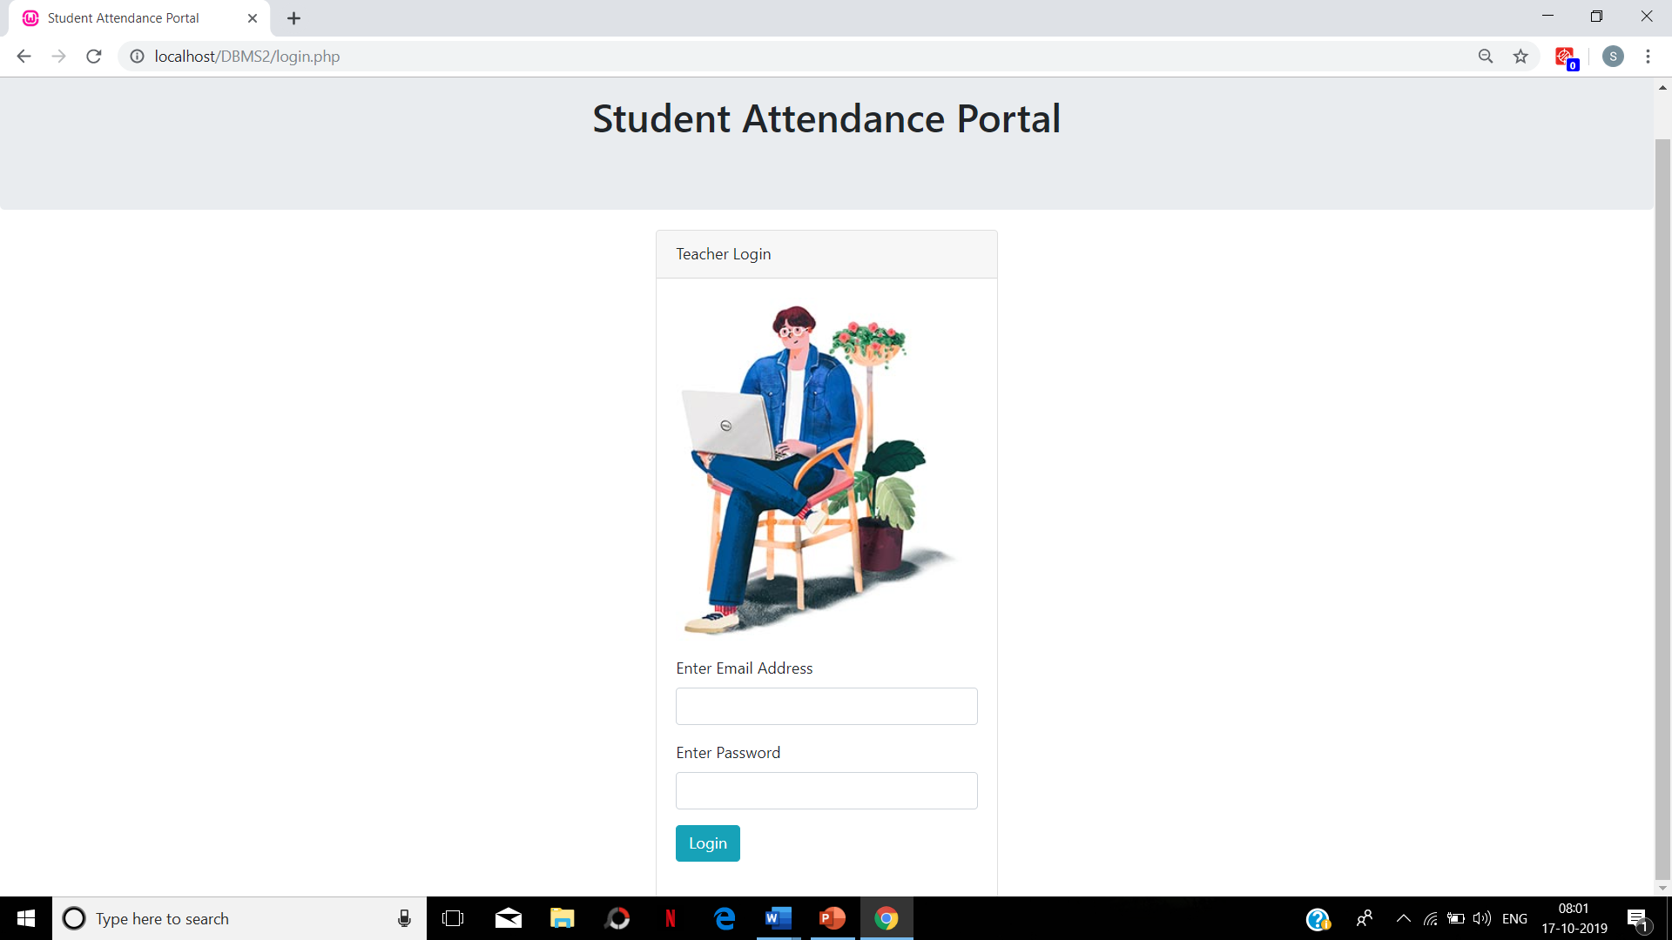

Slide 3
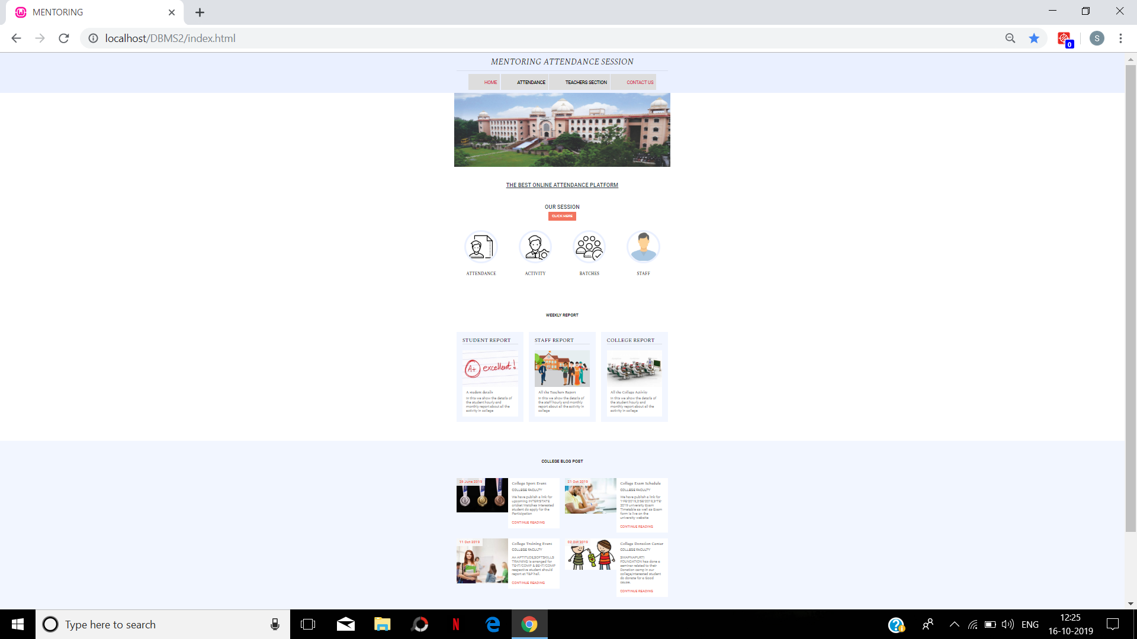

Slide 4
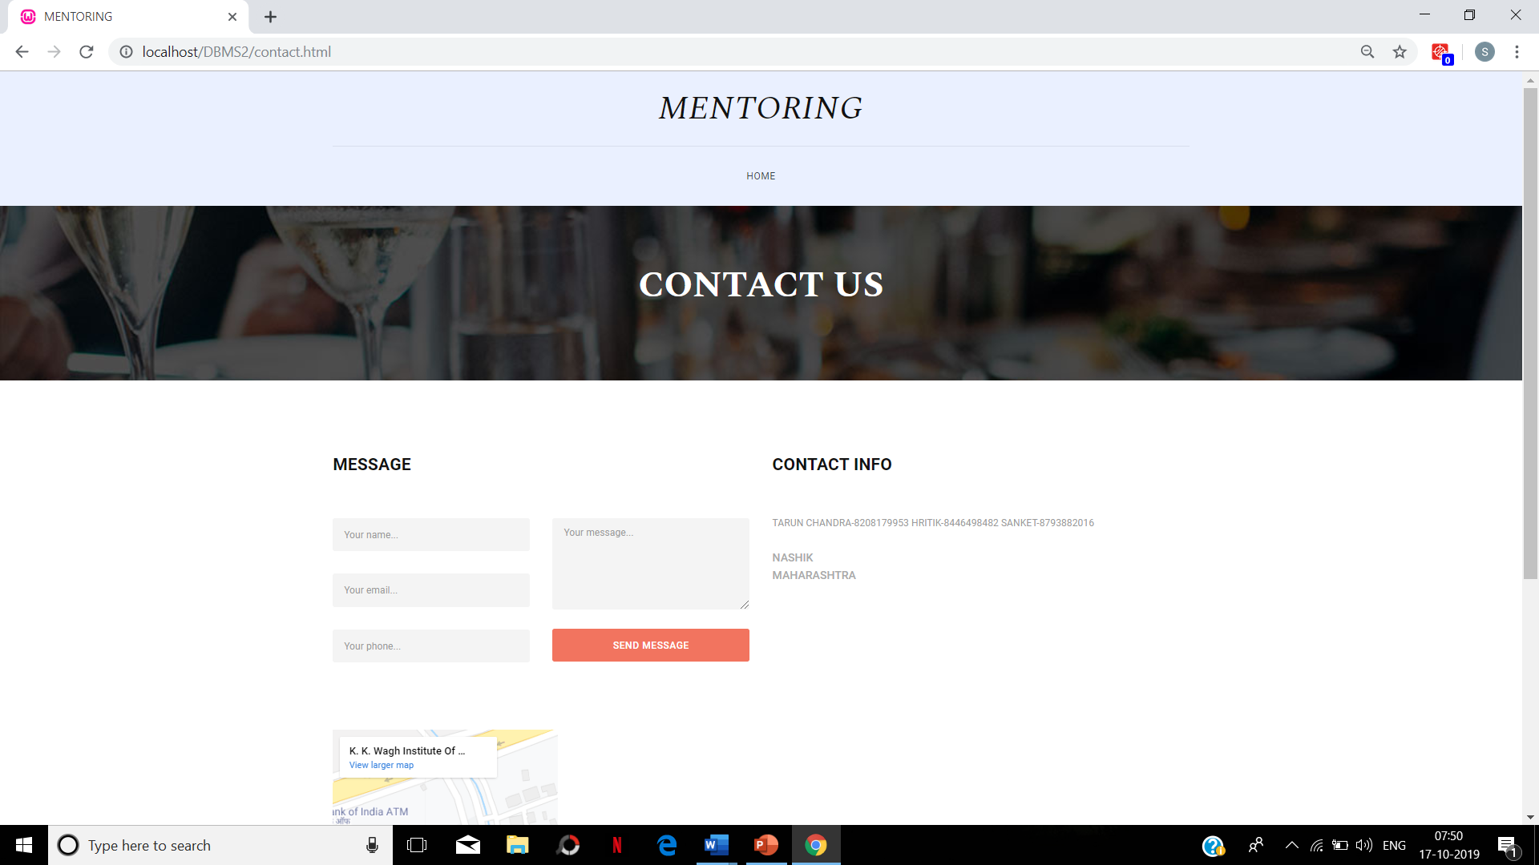

Slide 5
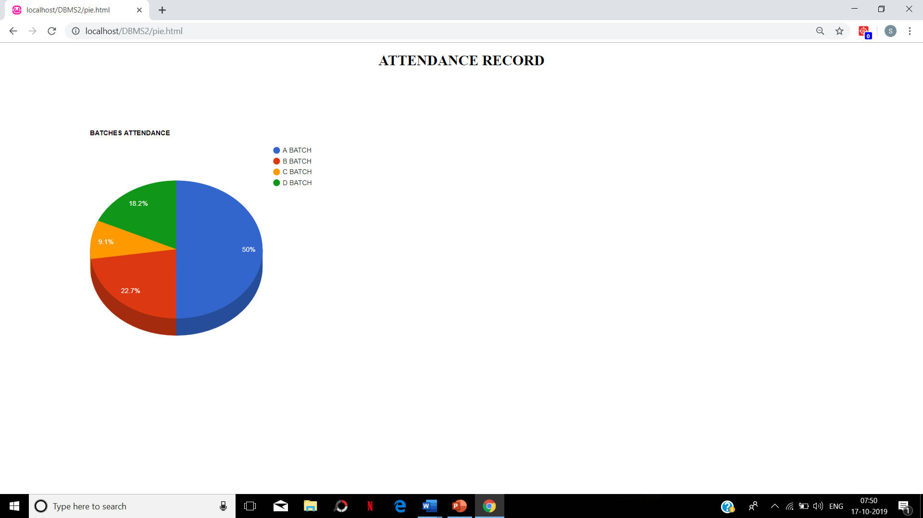

Slide 6
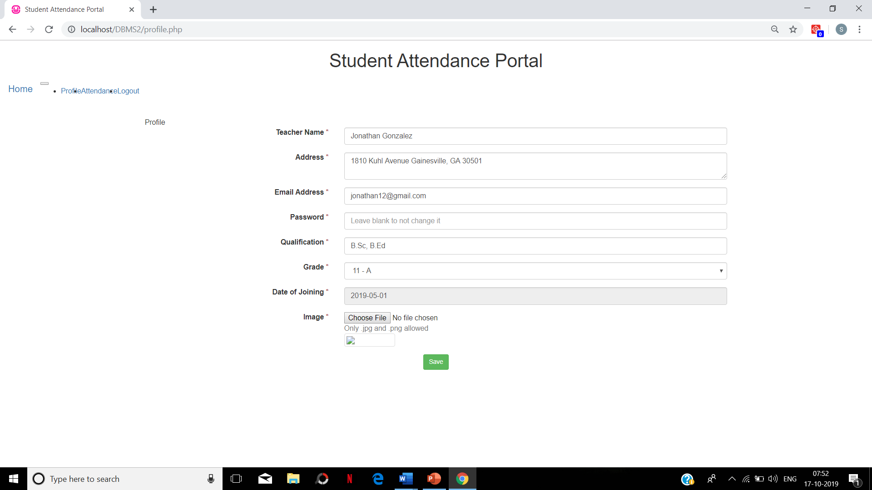

Slide 7
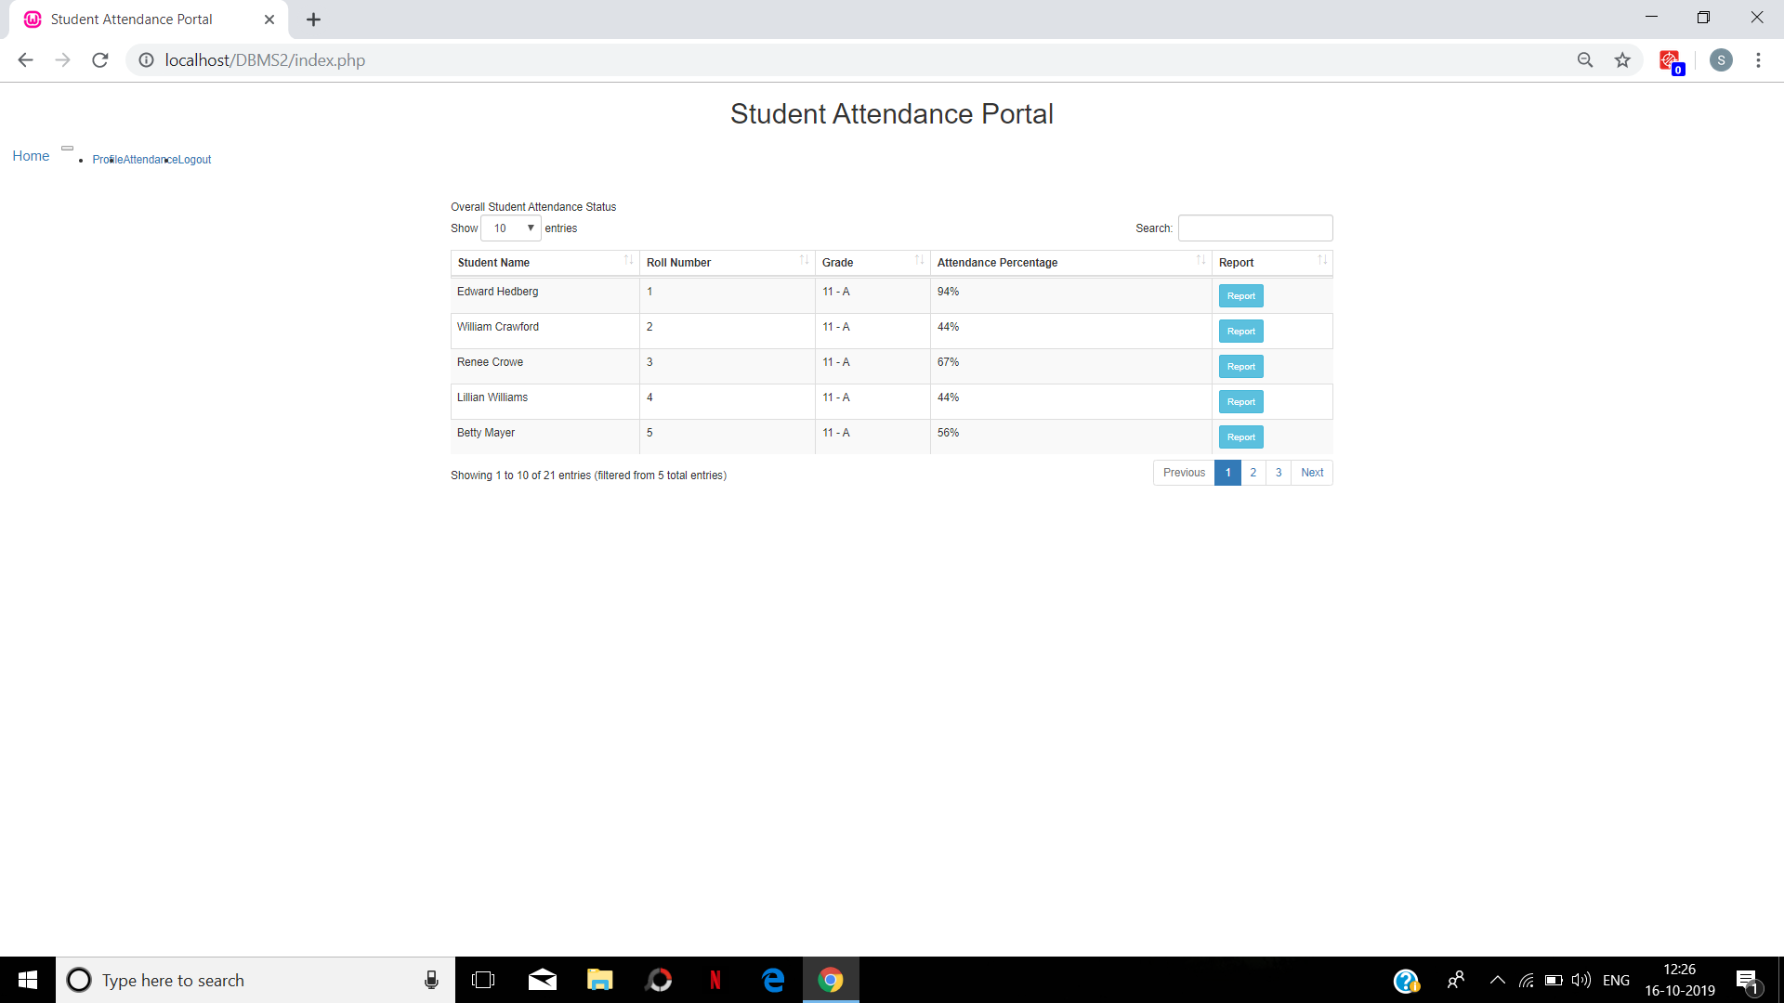

Slide 8
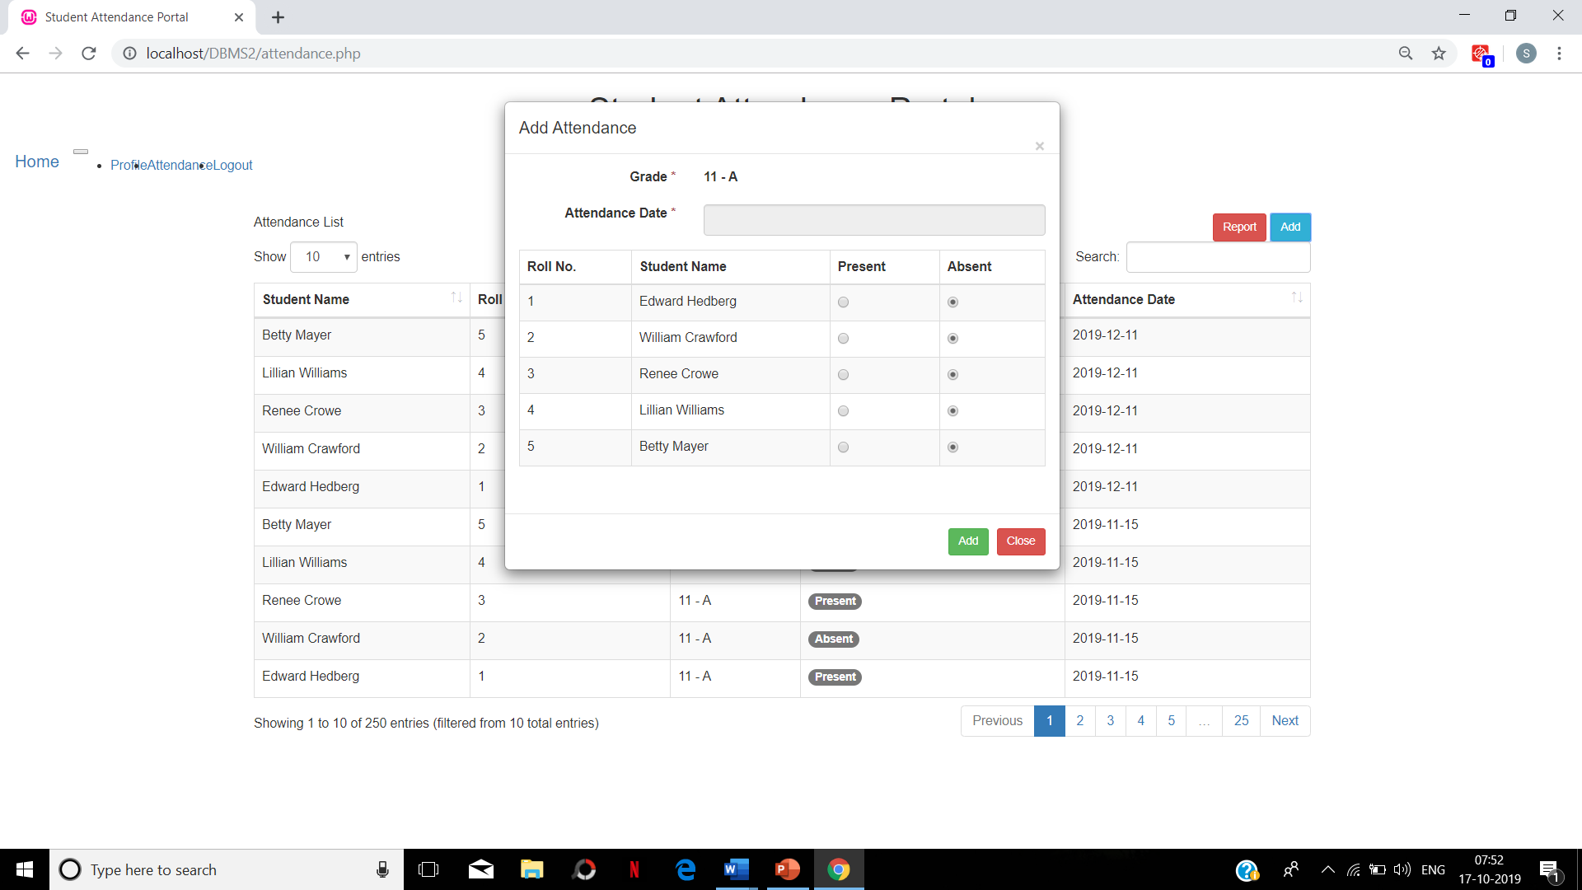

Slide 9
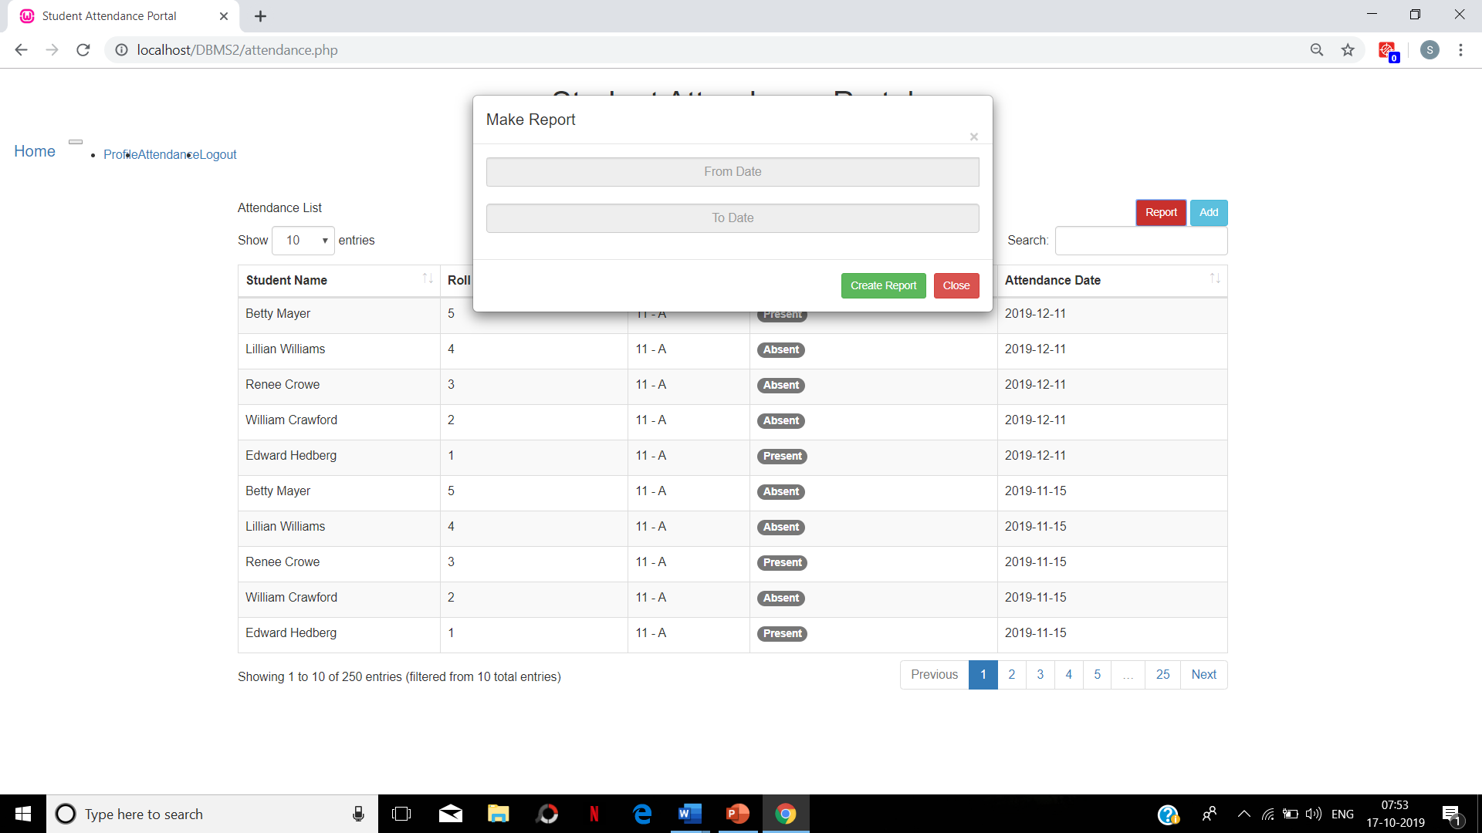

Slide 10
Thank you….!

